Slide 1
IBM University Engagement Project Submission
“Exploring the Power of Agentic AI with IBM Granite and IBM Bob”

Slide 2

Project Tile – [TripMate – AI-Powered Travel Planner Agent]
Domain of Project – [ Travel & Tourism ]
Student Name | Recent Passport Photo | Email ID | Mobile number [WhatsApp]
AR Hafiz Muhammed |  | arhafizmuhammed@gmail.com | 9747012370
Recommended font style and size:
Font Style: Arial
Font Size (Heading): 28
Font Size (Content): 20

Slide 3
Problem Statement -
Problem Statement - Travel Planner Agent
The Challenge - A Travel Planner Agent is an AI-powered assistant that helps users plan trips efficiently
and intelligently.
It uses real-time data to suggest destinations, build itineraries, and recommend transport and
accommodation options.
By understanding user preferences, budgets, and constraints, it tailors personalized travel plans.
Integrated with maps, weather updates, and local guides, it ensures a smooth travel experience.
The agent can also manage bookings, alert users to changes, and optimize schedules on the go.
This smart assistant transforms complex travel planning into a seamless, enjoyable process.

Slide 4
Proposed Solution -
Proposed Solution: AI-Powered Travel Planner Agent (TripMate)
The proposed solution is a multi-agent AI-powered Travel Planner built using IBM Bob, IBM watsonx.ai, and Granite Models to provide personalized, real-time trip planning. The system addresses challenges in destination discovery, itinerary building, and budget management through an intelligent, modular architecture.
At its core, the solution uses a Retrieval-Augmented Generation (RAG) pipeline to fetch accurate travel information from a curated destination knowledge base. This data is embedded and stored in a vector database, enabling the system to retrieve and ground itinerary suggestions in real destination facts rather than hallucinated content, using Granite models for reasoning and generation.
The system consists of four key agents:
Destination Knowledge Agent retrieves and summarizes destination information, attractions, and local tips using RAG.
Itinerary Planning Agent generates a personalized day-by-day itinerary based on user inputs such as dates, budget, group size, and interests.
Budget Advisory Agent estimates costs per activity/day and flags when the plan exceeds the stated budget.
Refinement & Feedback Agent handles follow-up requests, regenerating only the affected portion of the itinerary rather than the whole plan.
The solution includes a user-friendly dashboard (built with React) that displays the day-by-day itinerary, cost breakdown, and weather outlook for the trip dates, and lets users save and revisit past trips.
IBM Bob is used to orchestrate agent workflows, while watsonx.ai ensures scalable model deployment, embeddings, and AI governance. Granite models power reasoning, summarization, and personalization.
Overall, this solution delivers an end-to-end intelligent travel assistant that turns fragmented trip research into a single, personalized, trustworthy planning experience.

Slide 5
Technology Used
IBM Bob platform -For designing and orchestrating multi-agent workflows visually
IBM Grainte model (for eg – ibm-granite-3-2-8b) – For natural language understanding, reasoning, and personalization
IBM Cloud – Provides the infrastructure to build, deploy, and scale the Travel Planner Agent efficiently
RAG– Fetches real destination data first, then generates itineraries, making recommendations more trustworthy and grounded
IBM Watsonx.ai - For model deployment, embeddings, and AI governance
Vector Database (FAISS/Chroma) – For RAG-based destination/attraction data retrieval
React (frontend) + MySQL – For the itinerary dashboard and trip history storage
Weather API (OpenWeatherMap) – For weather-aware activity suggestions

Slide 6
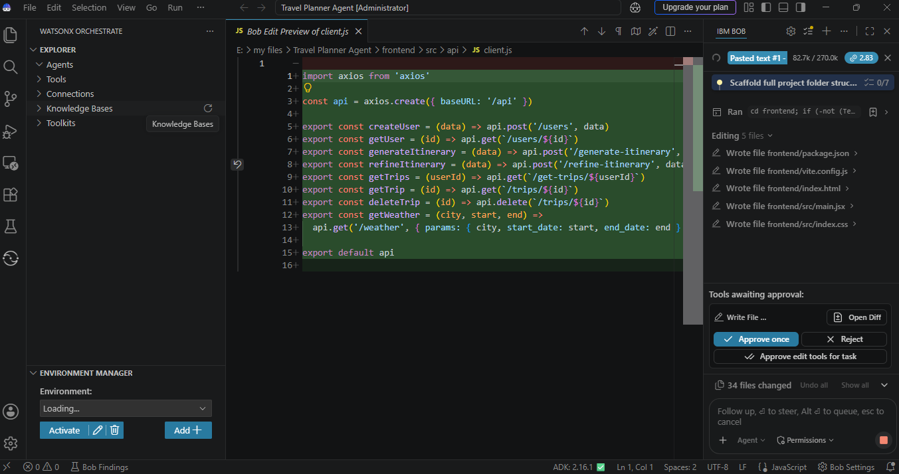
Required Files created using IBM bob -

Slide 7
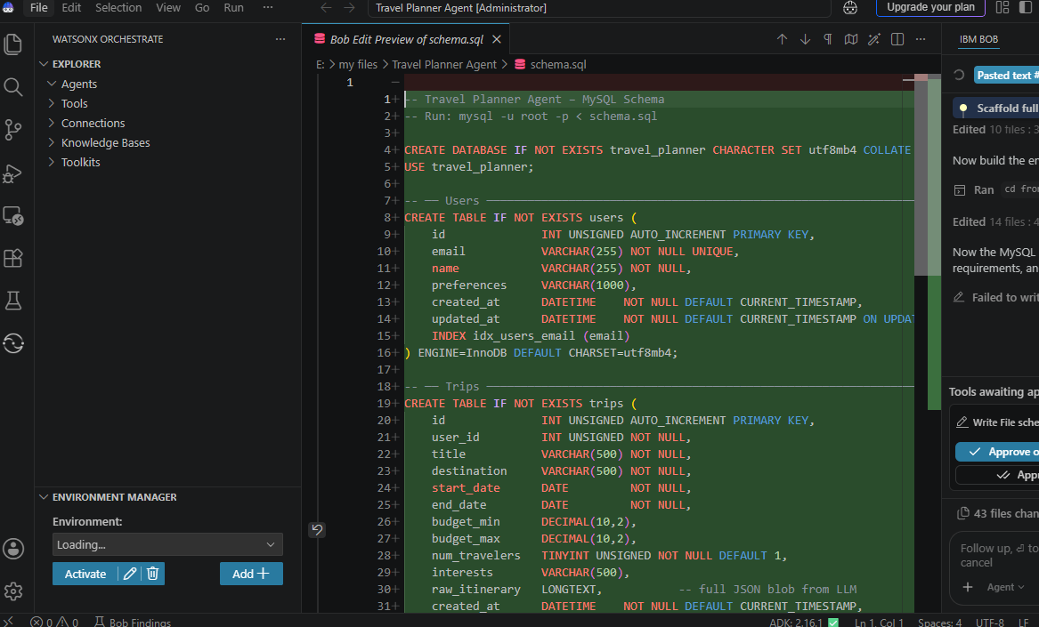
IBM Bob Screenshots:

Slide 8
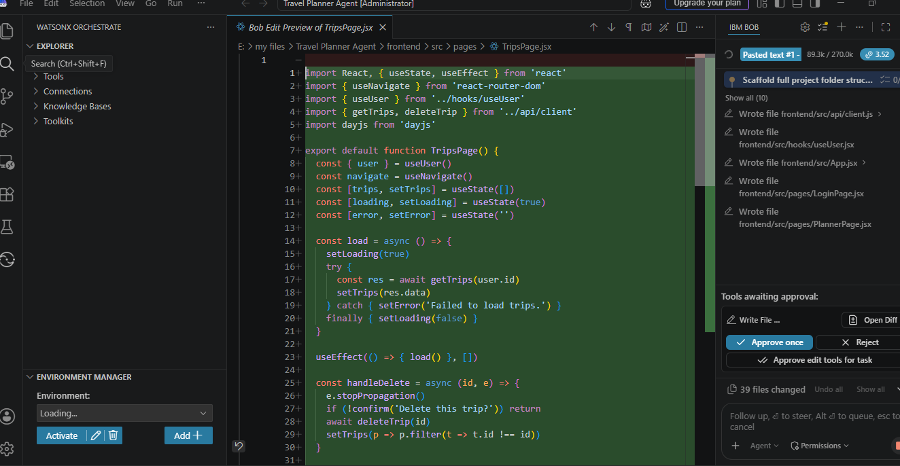

Slide 9
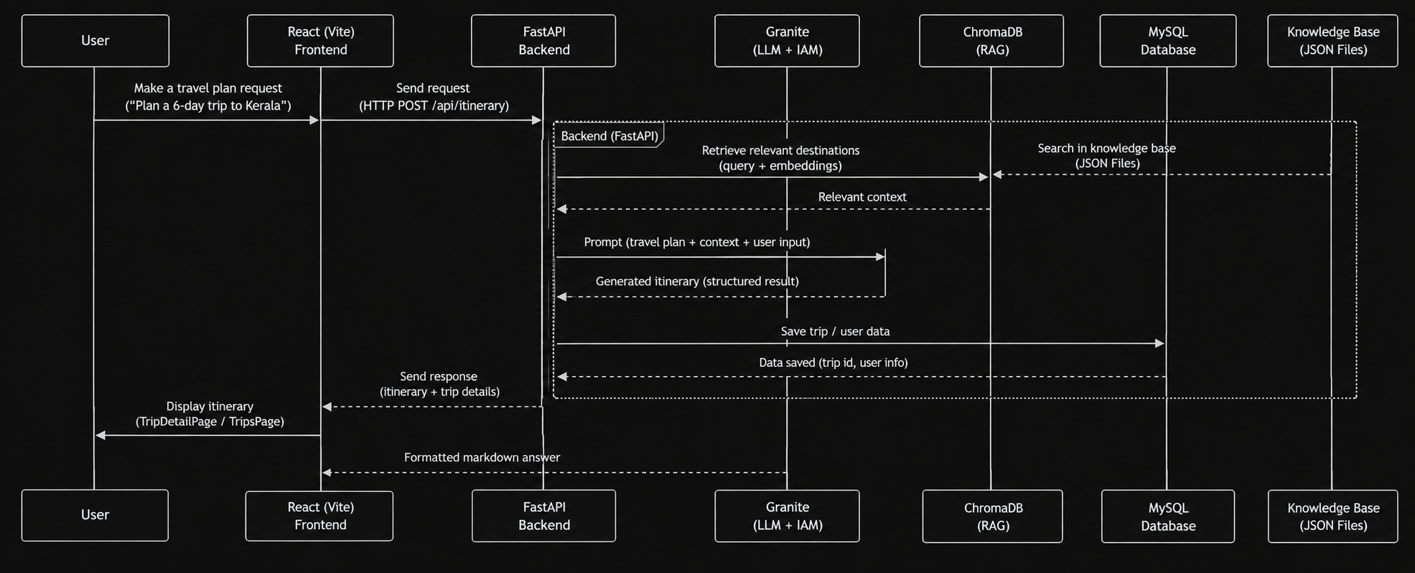
Architecture blueprint for IBM bob:

Slide 10

Role of Agentic AI in the solution
Role of Agentic AI in TripMate
Agentic AI enables the Travel Planner to function as an intelligent, autonomous trip-planning system rather than a simple chatbot. Using IBM watsonx.ai and IBM Granite models, it coordinates multiple specialized agents to deliver a complete, personalized itinerary.
Each agent performs a specific role — retrieving destination data, building the itinerary, tracking budget, and handling refinements — while working collaboratively. This multi-agent approach ensures efficient task execution and coherent, accurate trip plans.
Agentic AI also brings context awareness, understanding user details like travel dates, budget, and interests to generate tailored recommendations. It supports real-time adaptation, updating the itinerary as the user requests changes mid-conversation, without regenerating the entire plan.
Additionally, agents communicate with each other — for example, the Budget Advisory Agent flags a plan back to the Itinerary Planning Agent if costs exceed the stated budget — enabling better decision-making.
Overall, Agentic AI makes the system proactive, personalized, and goal-driven, acting like a smart digital travel agent that helps users go from a vague idea to a ready-to-follow trip plan.

Slide 11

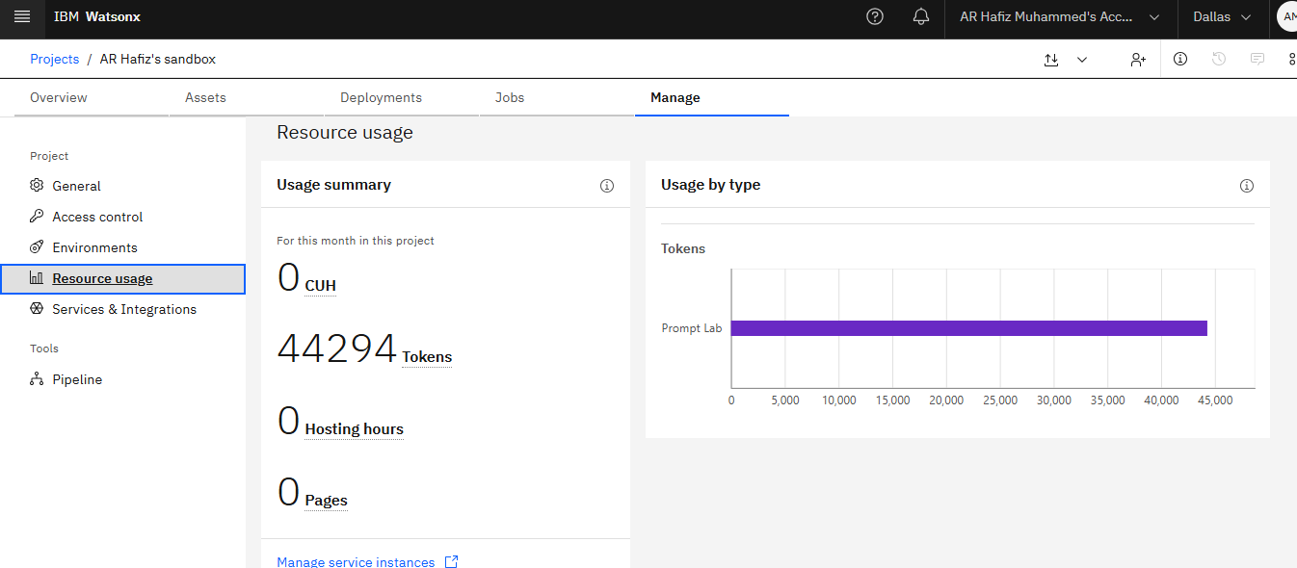
Token Usage
11,761 token are used
Before Prompt
After the Prompt
·
·
·

Slide 12
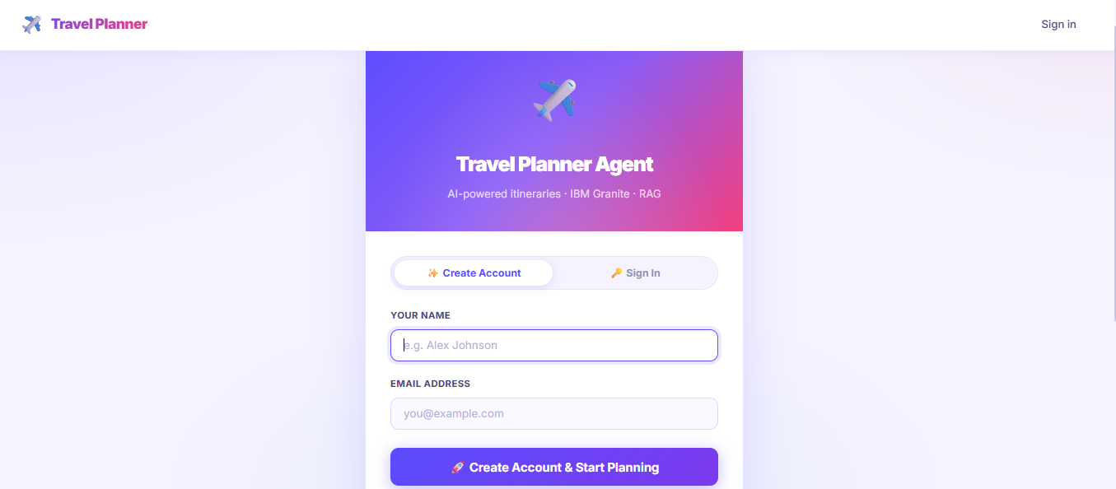
Project Output Screenshot
Please put IBM Bob output screenshots with 2-3 prompts.
You can take 2-3 more slides for each screenshot
·
·
·

Slide 13
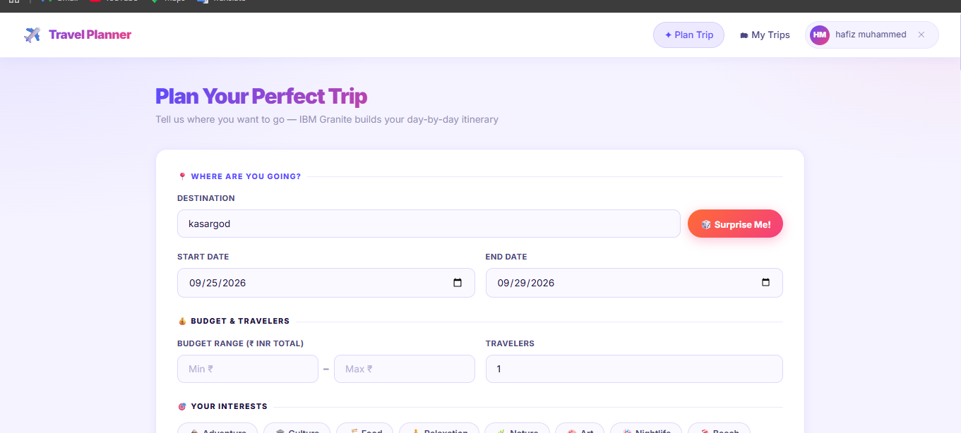
Project Output Screenshot
Please put IBM Bob output screenshots with 2-3 prompts.
You can take 2-3 more slides for each screenshot
·
·
·

Slide 14
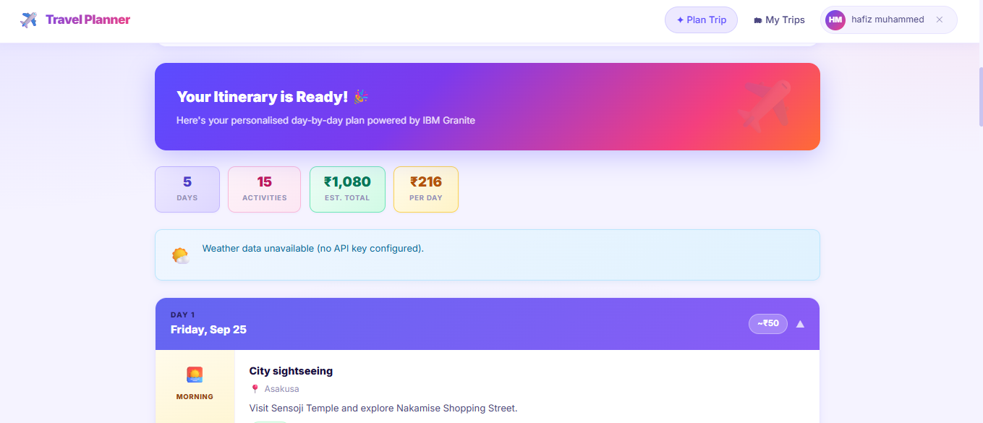
Project Output Screenshot
Please put IBM Bob output screenshots with 2-3 prompts.
You can take 2-3 more slides for each screenshot
·
·
·

Slide 15
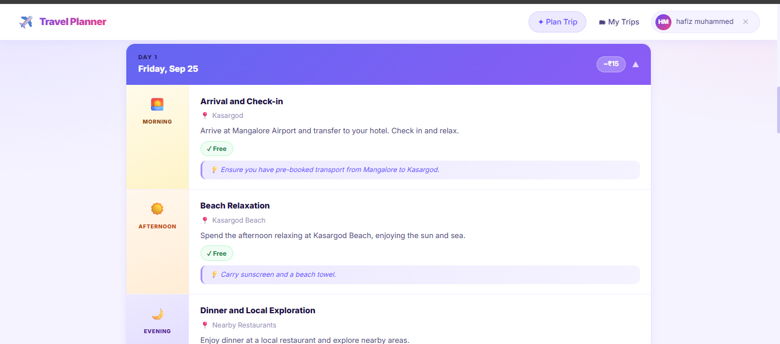

Slide 16
Novelty and Uniqueness
The proposed Travel Planner Agent stands out by combining Agentic AI, RAG, and personalization into a single intelligent system.
Multi-Agent Intelligence – Specialized agents collaborate to deliver a coherent, budget-aware itinerary instead of a generic list of suggestions.
RAG-Based Accuracy – Integrates real-time destination data retrieval with AI generation, reducing hallucinated recommendations.
Hyper-Personalization – Tailors itineraries based on budget, group size, interests, and trip duration.
Weather-Aware Recommendations – Flags outdoor activities at risk from forecasted weather and suggests alternatives..
Conversational Refinement Loop – Lets users adjust specific days without regenerating the whole plan.
Scalable & Enterprise-Ready – Built on IBM watsonx.ai with IBM Granite models, ensuring reliability and governance.
This makes the solution a smart, adaptive travel companion — not just a static itinerary generator.

Slide 17
Git Hub Link
· Please create public github repository (Enable Add README button while creating repository) with format –
Please test and Paste the working Github URL –
Make sure you have Uploaded following three files into your github repository
1) All Agent relevant files of IBM Cloud , 2) yourproblemstatement.pdf file 3) your projectpresntation.pptx file 4)any other files
·
·
·

Slide 18
Future Scope
1.Booking Integration–
Connect with flight, hotel, and transport booking APIs to move from planning to actual reservation and payment, with real-time price and availability checks.
2.Multilingual & Voice Support –
.Add voice-enabled interaction and multilingual support so travelers from diverse linguistic backgrounds can plan trips naturally in their preferred language.
·
·
·

Slide 19
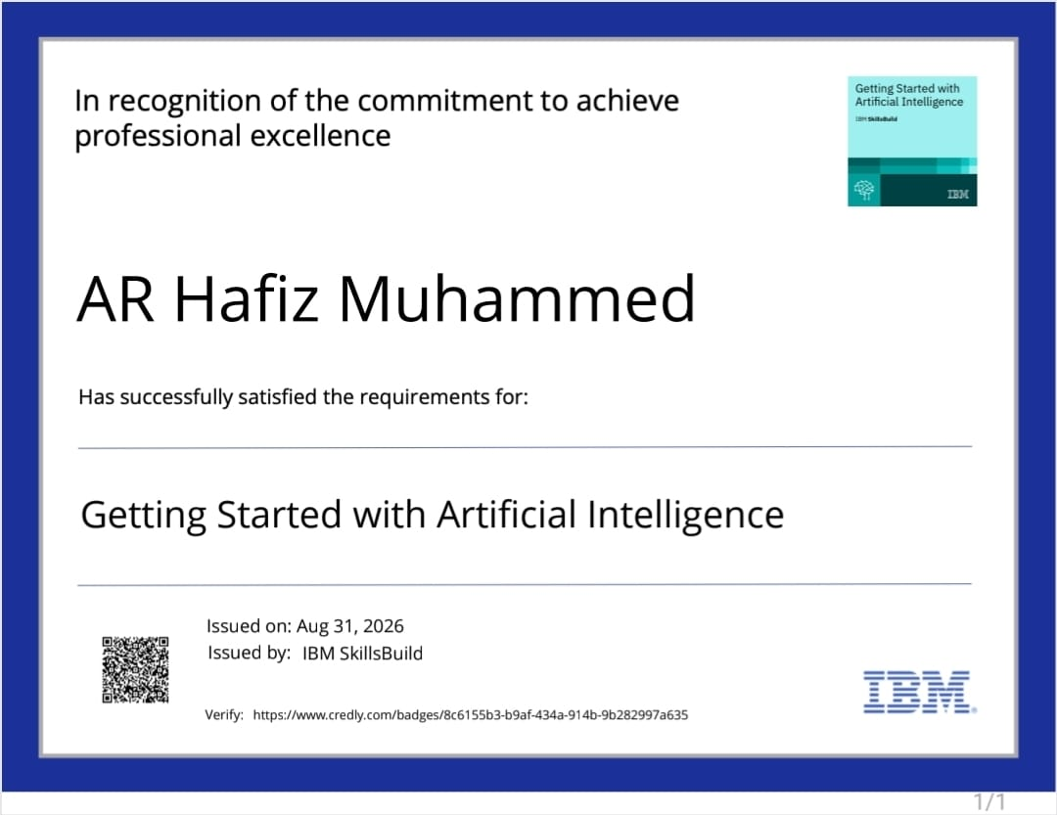
Certificates Earned:
(Getting Started with Artificial Intelligence)

Slide 20
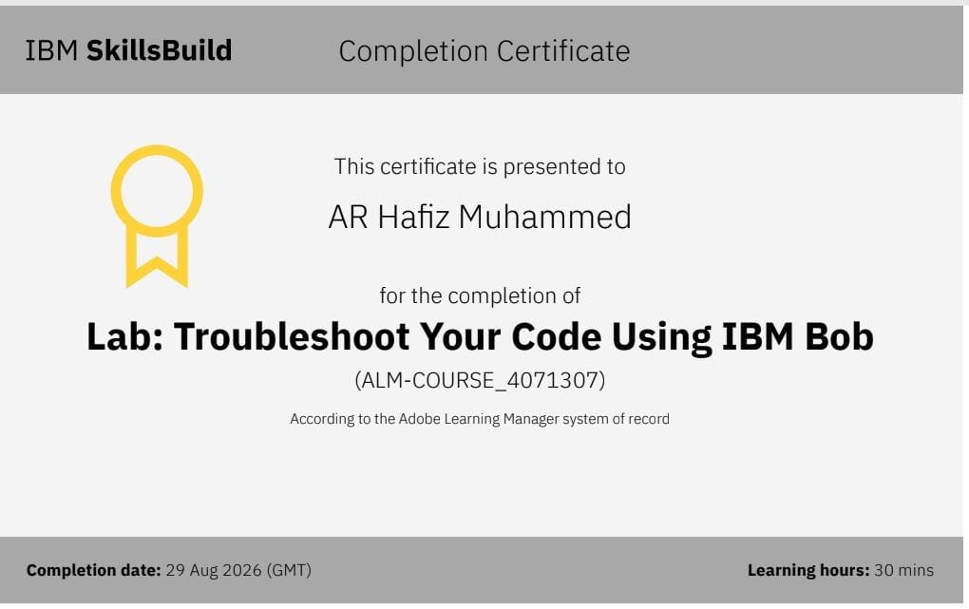
Certificates Earned:​
Add your IBM BOB Certificate

Slide 21


